Slide 1
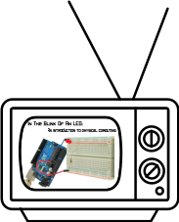
Previously On...
Voltage, Current and Resistance

Slide 2
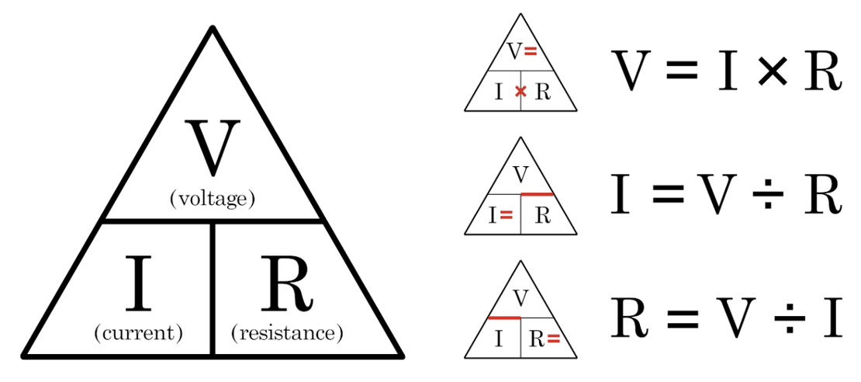
Ohm’s Law

Slide 3
Previously On...
Voltage, Current and Resistance

Slide 4
Previously On...
Voltage, Current and Resistance
Inputs and Outputs

Slide 5
Previously On...
Voltage, Current and Resistance
Inputs and Outputs
Digital Vs. Analog

Slide 6
Previously On...
Voltage, Current and Resistance
Inputs and Outputs
Digital Vs. Analog
Commands

Slide 7
Previously On...
Voltage, Current and Resistance
Inputs and Outputs
Digital Vs. Analog
Commands
pinMode(pin, INPUT/OUTPUT);
digitalWrite(pin, HIGH/LOW);
delay(ms);
analogWrite(pin, 0-255);

Slide 8
Previously On...
Voltage, Current and Resistance
Inputs and Outputs
Digital Vs. Analog
Commands
pinMode(pin, INPUT/OUTPUT);
digitalWrite(pin, HIGH/LOW);
delay(ms);
analogWrite(pin, 0-255);
Functions

Slide 9
Previously On...
Voltage, Current and Resistance
Inputs and Outputs
Digital Vs. Analog
Commands
pinMode(pin, INPUT/OUTPUT);
digitalWrite(pin, HIGH/LOW);
delay(ms);
analogWrite(pin, 0-255);
Functions
void setup() {}
void loop() {}

Slide 10
Previously On...
Voltage, Current and Resistance
Inputs and Outputs
Digital Vs. Analog
Commands
pinMode(pin, INPUT/OUTPUT);
digitalWrite(pin, HIGH/LOW);
delay(ms);
analogWrite(pin, 0-255);
Functions
void setup() {}
void loop() {}
Comments
// Keep things clear

Slide 11
Previously On...
Voltage, Current and Resistance
Inputs and Outputs
Digital Vs. Analog
Commands
pinMode(pin, INPUT/OUTPUT);
digitalWrite(pin, HIGH/LOW);
delay(ms);
analogWrite(pin, 0-255);
Functions
void setup() {}
void loop() {}
Comments
// Keep things clear
Variables
int led = 9;
int brightness = brightness + 1;

Slide 12


The Most Important Lesson
Notes:
This is why there’s a diversity problem in Engineering

Slide 13
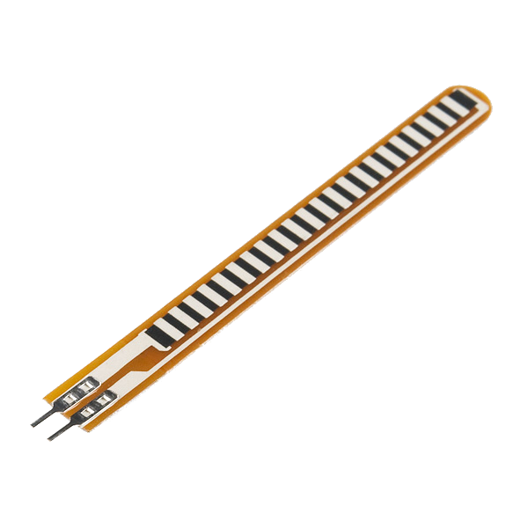
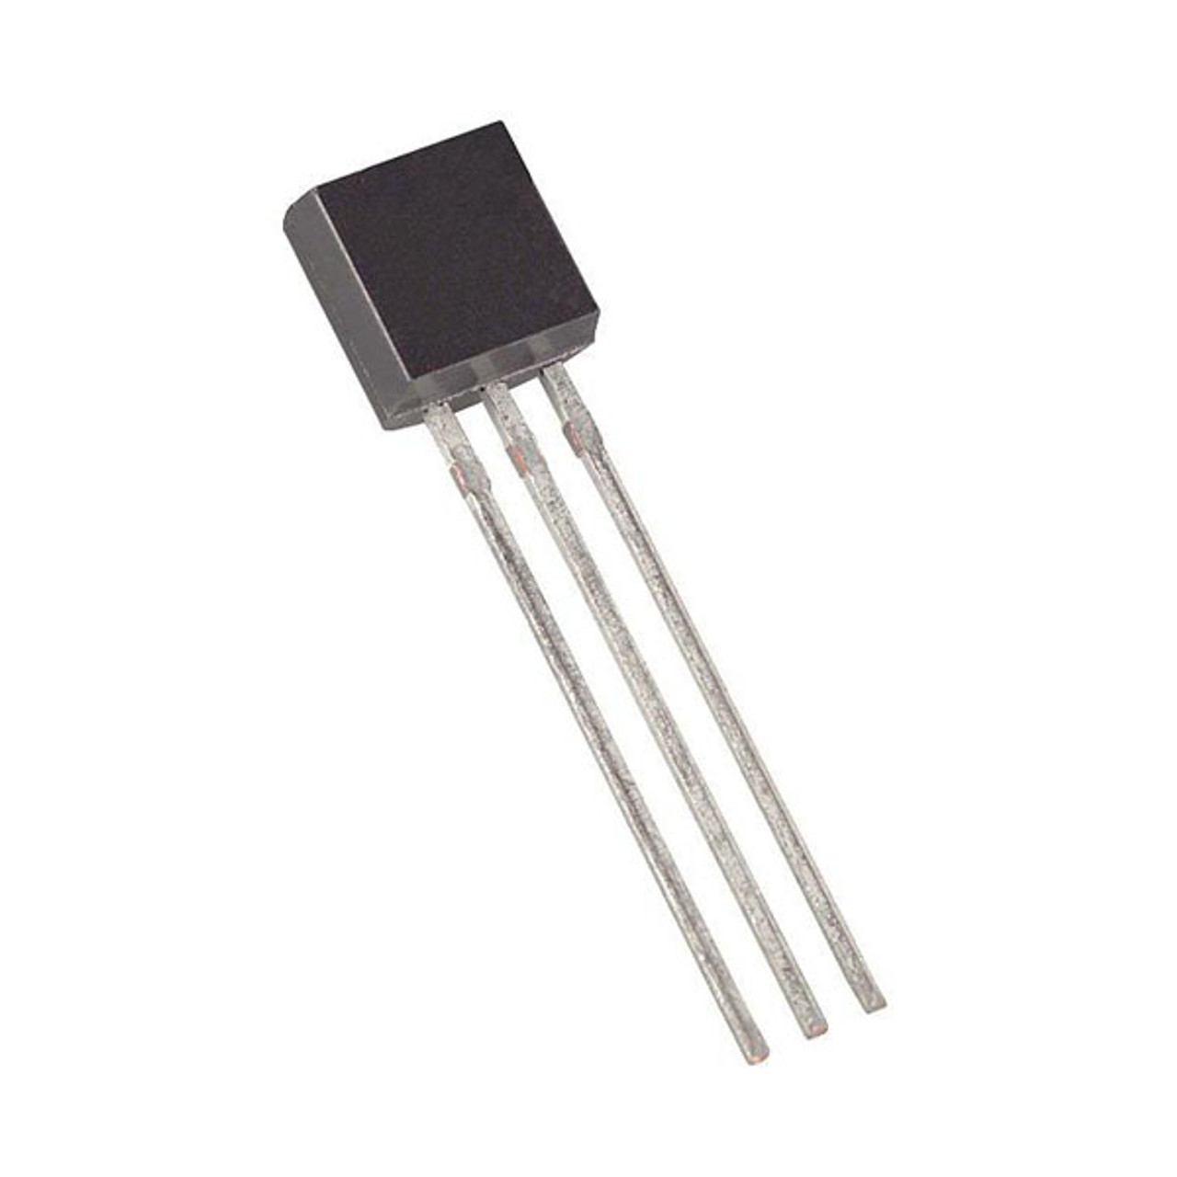

Inputs!
Input is any signal entering an electrical system
Both digital and analog sensors are forms of input
Input can also take many other forms: a keyboard, a mouse, infrared sensors, biometric sensors, touch sensors, cameras or just plain voltage from a circuit
This is how you can make a computer react to the world around it

Slide 14
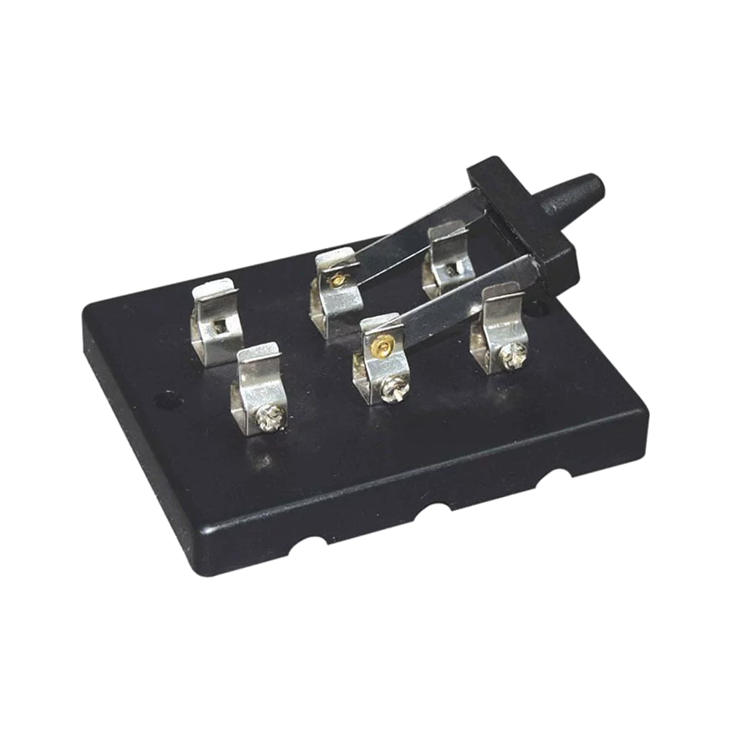
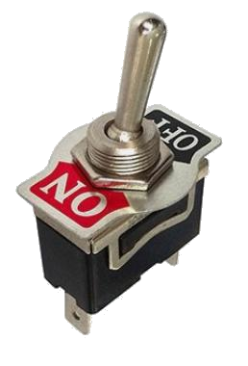
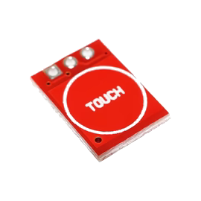
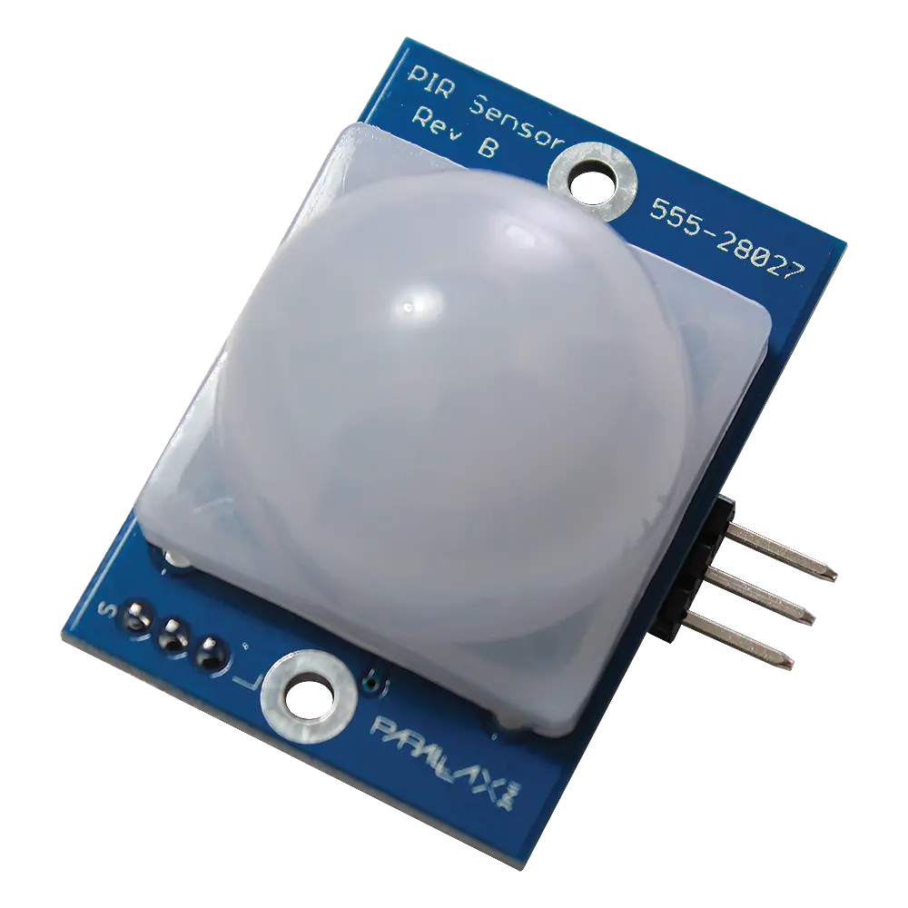
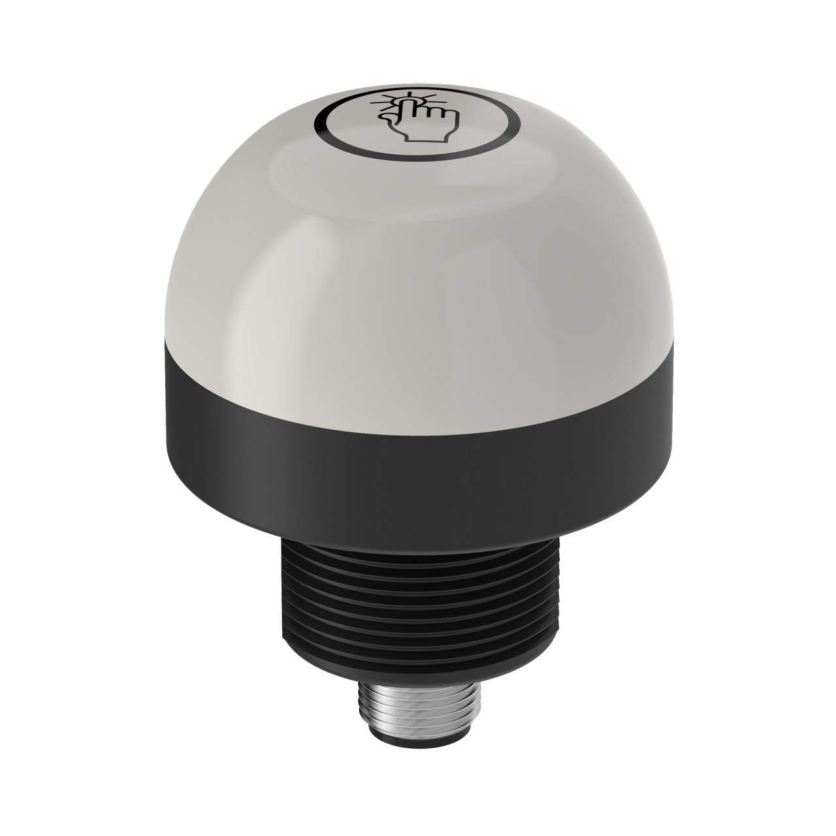
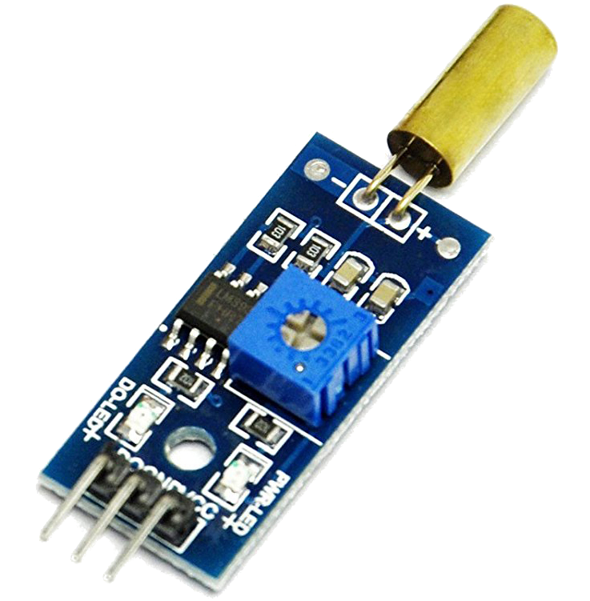
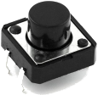
Digital Input
Like digital output, can only sense if a signal is high or low
For Arduino
High is voltage above 3 V
Low is voltage below 1.5 V
General category is “switches”
Includes push buttons (momentary switches), toggle switches, knife switches (maintained switches), capacitive/touch switches, and many other sensors

Slide 15
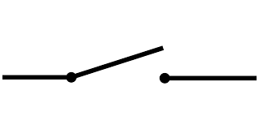
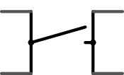
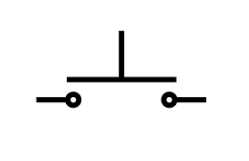
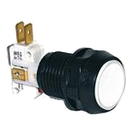
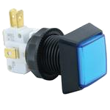
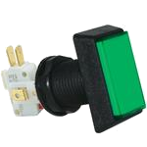
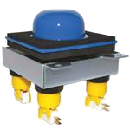
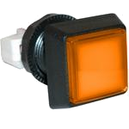
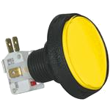
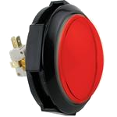
Component Spotlight: The Push Button / Momentary Switch

Slide 16
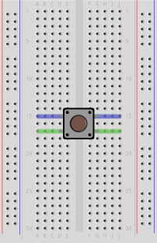
Push Button and Breadboard Connections
Our buttons have to bridge the gap on our breadboards
The top pins are connected to each other and so are the bottom ones

Slide 17
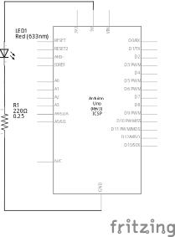
Using the Breadboard to Built a Simple Input Circuit
Remember our original circuit?

Slide 18
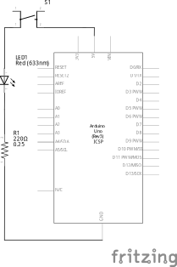
Using the Breadboard to Built a Simple Input Circuit
Remember our original circuit?
We’re going to wire that up again, but this time with a switch

Slide 19

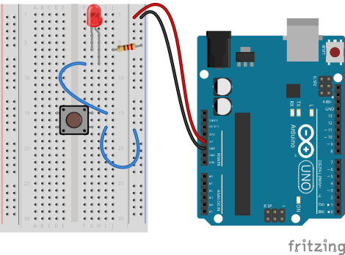
Using the Breadboard to Built a Simple Input Circuit

Slide 20
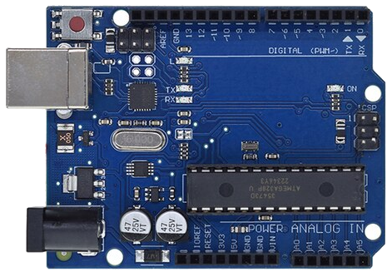
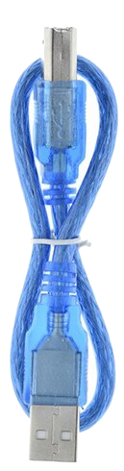

Go ahead and plug your board in!

Slide 21

Adding Control

Slide 22
Adding Control
Any circuit that has meaningful input has some degree of control

Slide 23
Adding Control
Any circuit that has meaningful input has some degree of control
Microcontrollers allow us to assign different relationships between inputs and outputs

Slide 24
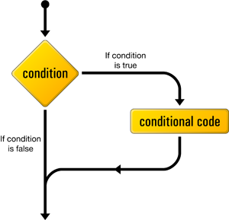
if() statements / Boolean logic
Project #3 – Lie Detector
Just give me 3 clock cycles with the perp...
Psuedo-code – how should this work?
Green LED turns on
Statement true?
YES
NO
Red LED turns on

Slide 25
Project #3 – Lie Detector Inputs and Outputs
Green LED turns on
Statement true?
YES
NO
Red LED turns on
Inputs | Outputs
None | Green LED
 | Red LED
Notes:
Our program is running hundreds of thousands of times every second

Slide 26
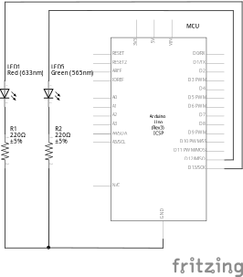
Project #3 – Lie Detector Schematic
You can leave the button on the breadboard- we’ll be using it again soon

Slide 27
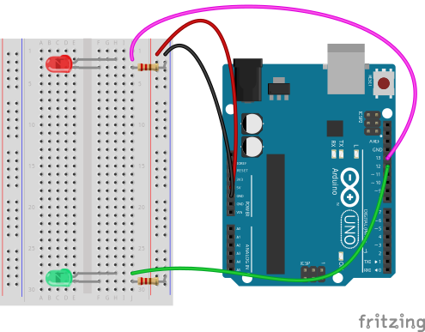
Project #3 – Lie Detector Wiring Diagram

Slide 28
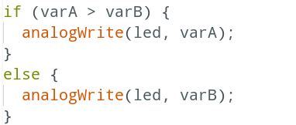
Project #3 – Lie Detector Conditional Statements
the if() statement

Slide 29
Project #3 – Lie Detector Conditional Statements
If this is true

Slide 30
Project #3 – Lie Detector Conditional Statements
If this is true
Do this

Slide 31
Project #3 – Lie Detector Conditional Statements
If this is true
Do this
Otherwise

Slide 32
Project #3 – Lie Detector Conditional Statements
If this is true
Do this
Otherwise
Do this

Slide 33
Boolean Operators
<Boolean> | True if:
(a) | a is true, HIGH or does not equal zero
(!a) | a is false, LOW or equals zero
(a) == (b) | a is equal to b
(a) != (b) | a is not equal to b
(a) > (b) | a is greater than b
(a) >= (b) | a is greater than or equal to b
(a) < (b) | a is less than b
(a) <= (b) | a is less than or equal to b
(a) && (b) | both a is true AND b is true
(a) || (b) | either a is true OR b is true

Slide 34
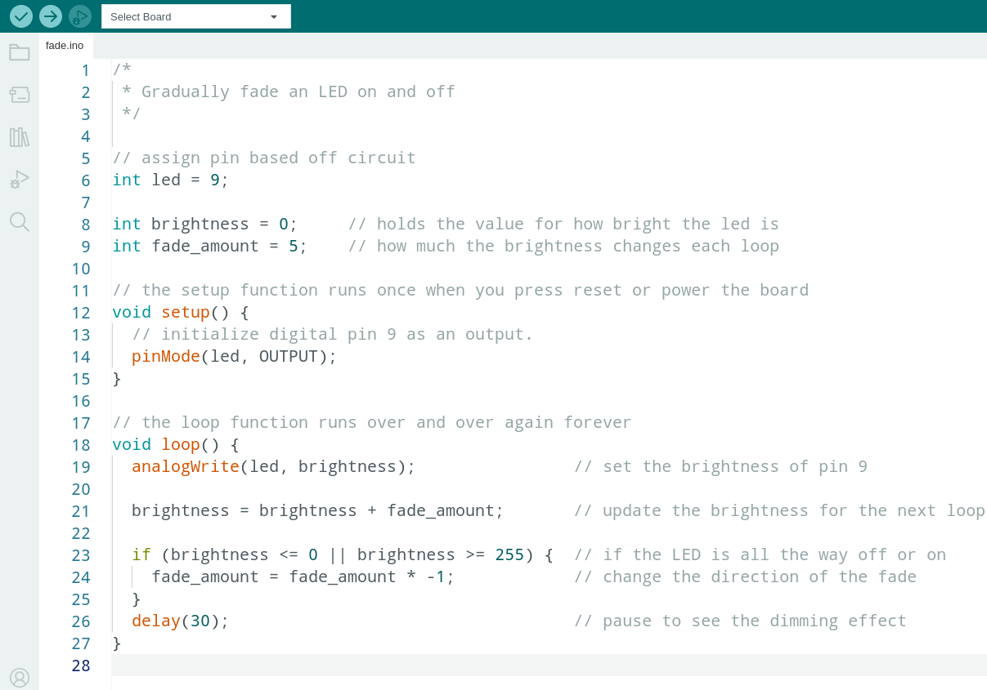
Déjà Vu

Slide 35
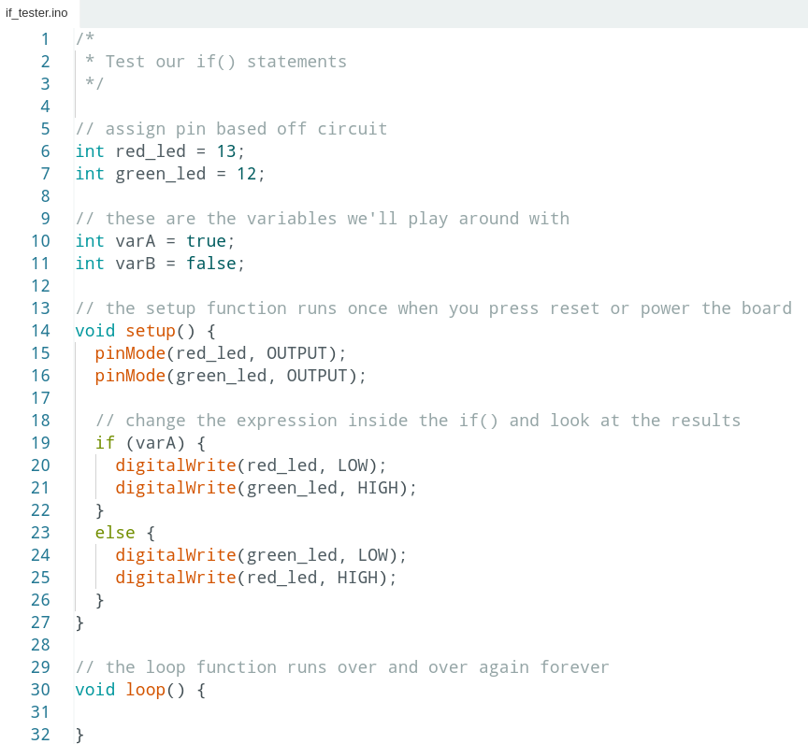

Project #3 – Lie Detector Code Review
1 | /*
2 | * Test our if() statements
3 | */
4
5 | // assign pin based off circuit
6 | int red_led = 13;
7 | int green_led = 12;
8
9 | // these are the variables we'll play around with
10 | int a = true;
11 | int b = false;
12
13 | // the setup function runs once when you press reset or power the board
14 | void setup() {
15 | pinMode(red_led, OUTPUT);
16 | pinMode(green_led, OUTPUT);
17
18 | // change the expression inside the if() and look at the results
19 | if (a) {
20 | digitalWrite(red_led, LOW);
21 | digitalWrite(green_led, HIGH);
22 | }
23 | else {
24 | digitalWrite(green_led, LOW);
25 | digitalWrite(red_led, HIGH);
26 | }
27 | }
28
29 | // the loop function runs over and over again forever
30 | void loop() {
31
32 | }

Slide 36
Project #3 – Lie Detector Code Review
1 | /*
2 | * Test our if() statements
3 | */
4
5 | // assign pin based off circuit
6 | int red_led = 13;
7 | int green_led = 12;
8
9 | // these are the variables we'll play around with
10 | int a = true;
11 | int b = false;
12
13 | // the setup function runs once when you press reset or power the board
14 | void setup() {
15 | pinMode(red_led, OUTPUT);
16 | pinMode(green_led, OUTPUT);
17
18 | // change the expression inside the if() and look at the results
19 | if (b) {
20 | digitalWrite(red_led, LOW);
21 | digitalWrite(green_led, HIGH);
22 | }
23 | else {
24 | digitalWrite(green_led, LOW);
25 | digitalWrite(red_led, HIGH);
26 | }
27 | }
28
29 | // the loop function runs over and over again forever
30 | void loop() {
31
32 | }

Slide 37
Project #3 – Lie Detector Code Review
1 | /*
2 | * Test our if() statements
3 | */
4
5 | // assign pin based off circuit
6 | int red_led = 13;
7 | int green_led = 12;
8
9 | // these are the variables we'll play around with
10 | int a = true;
11 | int b = false;
12
13 | // the setup function runs once when you press reset or power the board
14 | void setup() {
15 | pinMode(red_led, OUTPUT);
16 | pinMode(green_led, OUTPUT);
17
18 | // change the expression inside the if() and look at the results
19 | if (!b) {
20 | digitalWrite(red_led, LOW);
21 | digitalWrite(green_led, HIGH);
22 | }
23 | else {
24 | digitalWrite(green_led, LOW);
25 | digitalWrite(red_led, HIGH);
26 | }
27 | }
28
29 | // the loop function runs over and over again forever
30 | void loop() {
31
32 | }

Slide 38
Project #3 – Lie Detector Code Review
1 | /*
2 | * Test our if() statements
3 | */
4
5 | // assign pin based off circuit
6 | int red_led = 13;
7 | int green_led = 12;
8
9 | // these are the variables we'll play around with
10 | int a = true;
11 | int b = false;
12
13 | // the setup function runs once when you press reset or power the board
14 | void setup() {
15 | pinMode(red_led, OUTPUT);
16 | pinMode(green_led, OUTPUT);
17
18 | // change the expression inside the if() and look at the results
19 | if (!a) {
20 | digitalWrite(red_led, LOW);
21 | digitalWrite(green_led, HIGH);
22 | }
23 | else {
24 | digitalWrite(green_led, LOW);
25 | digitalWrite(red_led, HIGH);
26 | }
27 | }
28
29 | // the loop function runs over and over again forever
30 | void loop() {
31
32 | }

Slide 39
Project #3 – Lie Detector Code Review
1 | /*
2 | * Test our if() statements
3 | */
4
5 | // assign pin based off circuit
6 | int red_led = 13;
7 | int green_led = 12;
8
9 | // these are the variables we'll play around with
10 | int a = 9;
11 | int b = 5;
12
13 | // the setup function runs once when you press reset or power the board
14 | void setup() {
15 | pinMode(red_led, OUTPUT);
16 | pinMode(green_led, OUTPUT);
17
18 | // change the expression inside the if() and look at the results
19 | if (a > b) {
20 | digitalWrite(red_led, LOW);
21 | digitalWrite(green_led, HIGH);
22 | }
23 | else {
24 | digitalWrite(green_led, LOW);
25 | digitalWrite(red_led, HIGH);
26 | }
27 | }
28
29 | // the loop function runs over and over again forever
30 | void loop() {
31
32 | }

Slide 40
Project #3 – Lie Detector Code Review
1 | /*
2 | * Test our if() statements
3 | */
4
5 | // assign pin based off circuit
6 | int red_led = 13;
7 | int green_led = 12;
8
9 | // these are the variables we'll play around with
10 | int a = 9;
11 | int b = 5;
12
13 | // the setup function runs once when you press reset or power the board
14 | void setup() {
15 | pinMode(red_led, OUTPUT);
16 | pinMode(green_led, OUTPUT);
17
18 | // change the expression inside the if() and look at the results
19 | if (a < b) {
20 | digitalWrite(red_led, LOW);
21 | digitalWrite(green_led, HIGH);
22 | }
23 | else {
24 | digitalWrite(green_led, LOW);
25 | digitalWrite(red_led, HIGH);
26 | }
27 | }
28
29 | // the loop function runs over and over again forever
30 | void loop() {
31
32 | }

Slide 41
Project #3 – Lie Detector Code Review
1 | /*
2 | * Test our if() statements
3 | */
4
5 | // assign pin based off circuit
6 | int red_led = 13;
7 | int green_led = 12;
8
9 | // these are the variables we'll play around with
10 | int a = true;
11 | int b = 5;
12
13 | // the setup function runs once when you press reset or power the board
14 | void setup() {
15 | pinMode(red_led, OUTPUT);
16 | pinMode(green_led, OUTPUT);
17
18 | // change the expression inside the if() and look at the results
19 | if (b > 5 || a) {
20 | digitalWrite(red_led, LOW);
21 | digitalWrite(green_led, HIGH);
22 | }
23 | else {
24 | digitalWrite(green_led, LOW);
25 | digitalWrite(red_led, HIGH);
26 | }
27 | }
28
29 | // the loop function runs over and over again forever
30 | void loop() {
31
32 | }

Slide 42
Project #3 – Lie Detector Code Review
1 | /*
2 | * Test our if() statements
3 | */
4
5 | // assign pin based off circuit
6 | int red_led = 13;
7 | int green_led = 12;
8
9 | // these are the variables we'll play around with
10 | int a = true;
11 | int b = 5;
12
13 | // the setup function runs once when you press reset or power the board
14 | void setup() {
15 | pinMode(red_led, OUTPUT);
16 | pinMode(green_led, OUTPUT);
17
18 | // change the expression inside the if() and look at the results
19 | if (b > 5 && a) {
20 | digitalWrite(red_led, LOW);
21 | digitalWrite(green_led, HIGH);
22 | }
23 | else {
24 | digitalWrite(green_led, LOW);
25 | digitalWrite(red_led, HIGH);
26 | }
27 | }
28
29 | // the loop function runs over and over again forever
30 | void loop() {
31
32 | }

Slide 43
Project #3 – Lie Detector Code Review
1 | /*
2 | * Test our if() statements
3 | */
4
5 | // assign pin based off circuit
6 | int red_led = 13;
7 | int green_led = 12;
8
9 | // these are the variables we'll play around with
10 | int a = true;
11 | int b = 5;
12
13 | // the setup function runs once when you press reset or power the board
14 | void setup() {
15 | pinMode(red_led, OUTPUT);
16 | pinMode(green_led, OUTPUT);
17
18 | // change the expression inside the if() and look at the results
19 | if (b >= 5 && a) {
20 | digitalWrite(red_led, LOW);
21 | digitalWrite(green_led, HIGH);
22 | }
23 | else {
24 | digitalWrite(green_led, LOW);
25 | digitalWrite(red_led, HIGH);
26 | }
27 | }
28
29 | // the loop function runs over and over again forever
30 | void loop() {
31
32 | }

Slide 44
Boolean Operators
<Boolean> | True if:
(a) | a is true, HIGH or does not equal zero
(!a) | a is false, LOW or equals zero
(a) == (b) | a is equal to b
(a) != (b) | a is not equal to b
(a) > (b) | a is greater than b
(a) >= (b) | a is greater than or equal to b
(a) < (b) | a is less than b
(a) <= (b) | a is less than or equal to b
(a) && (b) | both a is true AND b is true
(a) || (b) | either a is true OR b is true

Slide 45
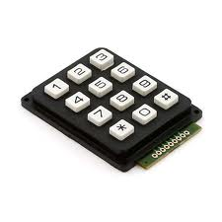
digitalRead()
Project #4 – Button/Maintained Switch Switch
Who you callin’ momentary?
Psuedo-code – how should this work?
LED turns off
Button Pressed?
LED
status?
ON
Rinse & Repeat
YES
OFF
LED turns on

Slide 46
digitalRead()
Project #4 – Button/Maintained Switch Switch
Who you callin’ momentary?
Psuedo-code – how should this work?
LED turns off
Button Pressed?
Pressed Before?
LED
status?
ON
Rinse & Repeat
YES
NO
OFF
LED turns on

Slide 47
Project #4 – Button/Maintained Switch Switch Inputs and Outputs
LED turns off
Button Pressed?
Pressed Before?
LED
status?
ON
Rinse & Repeat
YES
NO
OFF
LED turns on
Inputs | Outputs
Push Button | LED
Notes:
Our program is running hundreds of thousands of times every second

Slide 48
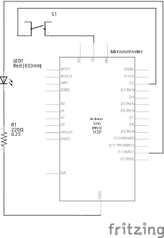
Transitioning to Micro-control Output & Input

Slide 49
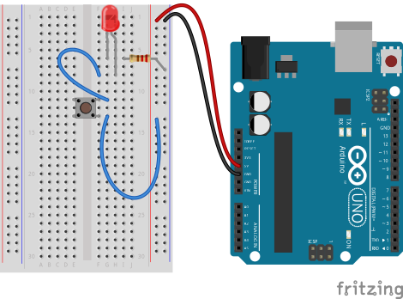
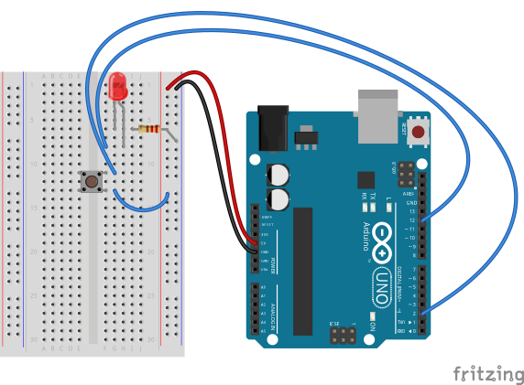
Transitioning to Micro-control Output & Input

Slide 50
Project #4 – Button/Maintained Switch Switch Wiring Diagram

Slide 51
Project #4 – Button/Maintained Switch Switch Wiring Diagram
WRONG!!!

Slide 52
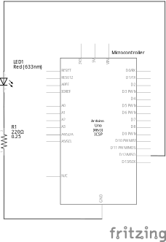
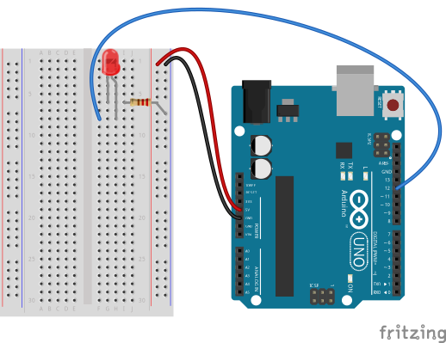
This Part Is Good

Slide 53
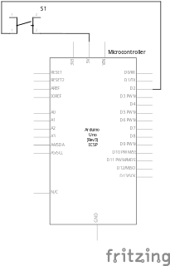
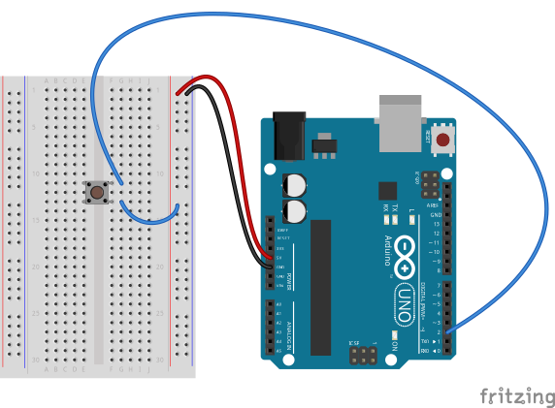
So This Must Be Bad…

Slide 54
So This Must Be Bad…
But Why?!

Slide 55
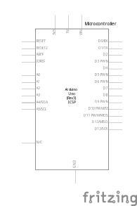

Another Water Analogy

Slide 56
Analogy Continued...

Slide 57
Analogy Continued...
?

Slide 58

All Stopped Up

Slide 59

All Stopped Up (kinda)

Slide 60
Switch Off

Slide 61

Switch On

Slide 62

Switch Off?!

Slide 63

Analogy Extended (Thin but holding)

Slide 64
So This Approach...

Slide 65
Doesn’t Work!

Slide 66
What About...

Slide 67
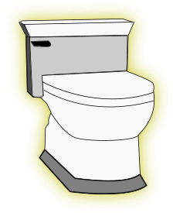
Changing Bathroom Fixtures?

Slide 68


Slide 69
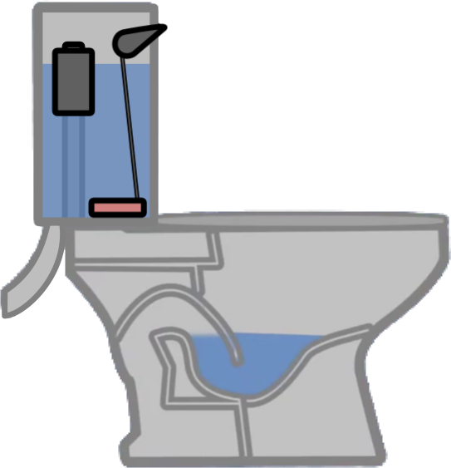

Getting Rid of the Unnecessary Crap

Slide 70
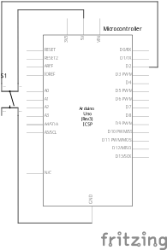
Changing the Viewpoint

Slide 71
Changing the Viewpoint

Slide 72
Changing the Viewpoint

Slide 73
Changing the Viewpoint

Slide 74
Switch Off

Slide 75

Switch On

Slide 76

Switch Right After Off

Slide 77
Switch Off

Slide 78
Stop Playin’ With the Commode!!

Slide 79

Possible Solution

Slide 80
How Do We Get Here?
?

Slide 81




Resistance Analogy
Water
Tower
Water
Tower
V
Big Pipe == Lower Resistance
Small Pipe == Higher Resistance

Slide 82
How Do We Get Here?
?

Slide 83
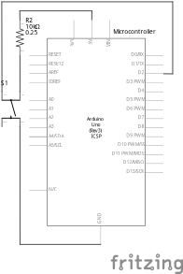
The Pull-Up Resistor!

Slide 84
But There’s A Trade-Off Between This...

Slide 85
…And This

Slide 86
It’s All About Compromise
10kΩ is a good value
(brown-black-black-red-gold)
or
(brown-black-orange-gold)

Slide 87
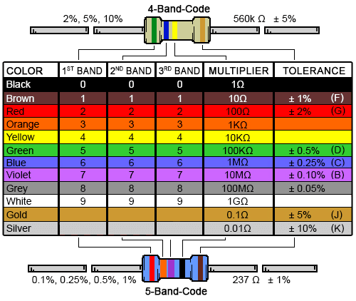
Decoding Resistor Values

Slide 88

Project #4 – Button/Maintained Switch Switch Input Schematic
Schematic of Pull-Up Resistor and Switch

Slide 89
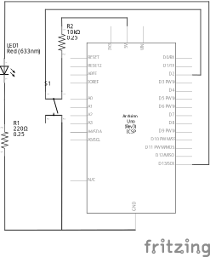
Project #4 – Button/Maintained Switch Switch Full Schematic
And the output is still the same as Project 1!

Slide 90
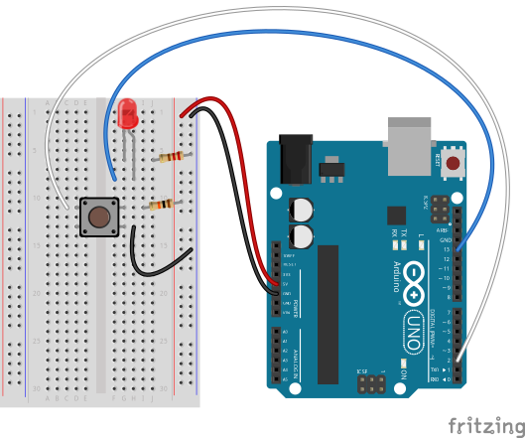
Project #4 – Button/Maintained Switch Switch Wiring Diagram

Slide 91
Project #4 – Button/Maintained Switch Switch Our First Input Commands!
pinMode(pin, INPUT/OUTPUT);
Notes:
Three commands to rule the world… or at least do 80% of cool Arduino projects.

Slide 92
Project #4 – Button/Maintained Switch Switch Our First Input Commands!
pinMode(pin, INPUT/OUTPUT);
ex: pinMode(2, INPUT);
Notes:
Three commands to rule the world… or at least do 80% of cool Arduino projects.

Slide 93
Project #4 – Button/Maintained Switch Switch Our First Input Commands!
pinMode(pin, INPUT/OUTPUT);
ex: pinMode(2, INPUT);
digitalRead(pin);
Notes:
Three commands to rule the world… or at least do 80% of cool Arduino projects.

Slide 94
Project #4 – Button/Maintained Switch Switch Our First Input Commands!
pinMode(pin, INPUT/OUTPUT);
ex: pinMode(2, INPUT);
digitalRead(pin);
ex: digitalRead(2);
Notes:
Three commands to rule the world… or at least do 80% of cool Arduino projects.

Slide 95
Project #4 – Button/Maintained Switch Switch Our First Input Commands!
pinMode(pin, INPUT/OUTPUT);
ex: pinMode(2, INPUT);
digitalRead(pin);
ex: digitalRead(2);
ex: int button_state = digitalRead(2);
Notes:
Three commands to rule the world… or at least do 80% of cool Arduino projects.

Slide 96
Project #4 – Button/Maintained Switch Switch Our First Input Commands!
pinMode(pin, INPUT/OUTPUT);
ex: pinMode(2, INPUT);
digitalRead(pin);
ex: digitalRead(2);
ex: int button_state = digitalRead(2);
button_state will either be HIGH or LOW
HIGH if switch is off, LOW if switch is on
Notes:
Three commands to rule the world… or at least do 80% of cool Arduino projects.

Slide 97
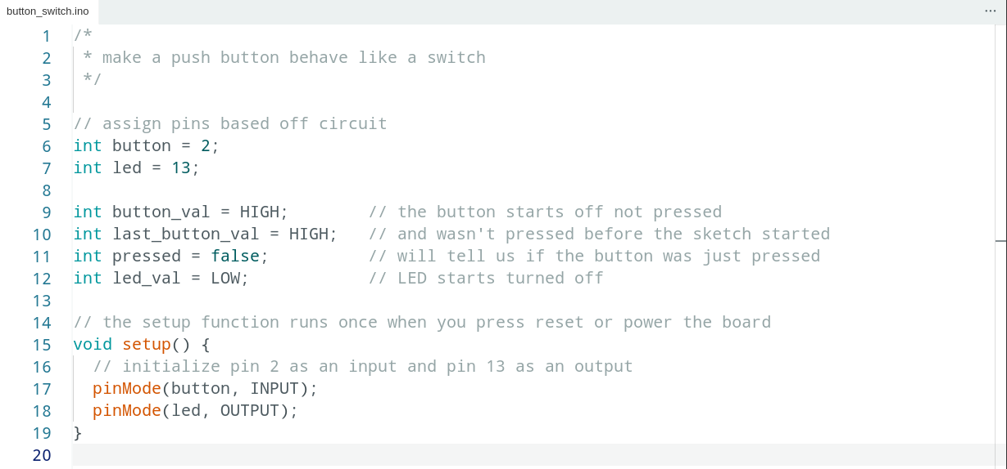
Project #4 – Button/Maintained Switch Switch Code Review

Slide 98

Code Review Continued

Slide 99


Code Review Continued

Slide 100
Project #4 – Button/Maintained Switch Switch Puzzles
Challenge 4a – Wire another LED. Make the button turn one off and the other on
Challenge 4b – Make an LED blink when you press the button (hint: look at File>Examples>Digital>Blink Without Delay)
Challenge 4c – Make an LED alternate between off, on and blink by pressing the button

Slide 101


Slide 102




Special Thanks:
www.sparkfun.com
6175 Longbow Drive, Suite 200
Boulder, Colorado 80301

